Slide 1

Shotmaniacs
Group 2

Slide 2
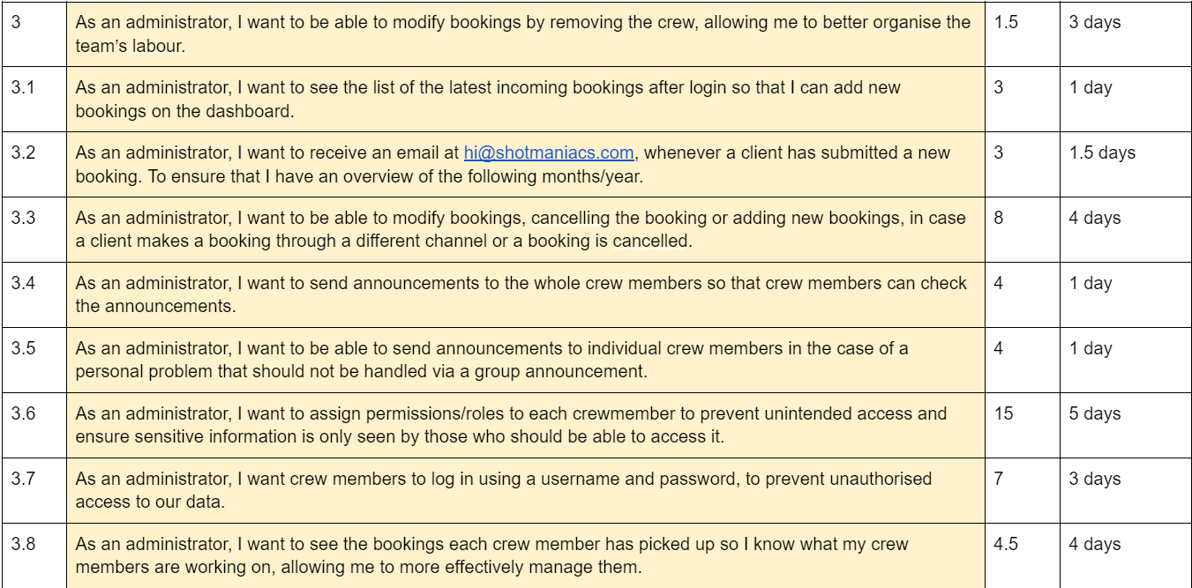
User Stories & Cost Estimation
65% of all story points were allocated to user stories for the administrator!
High in complexity
Security concerns will also need addressing

Slide 3
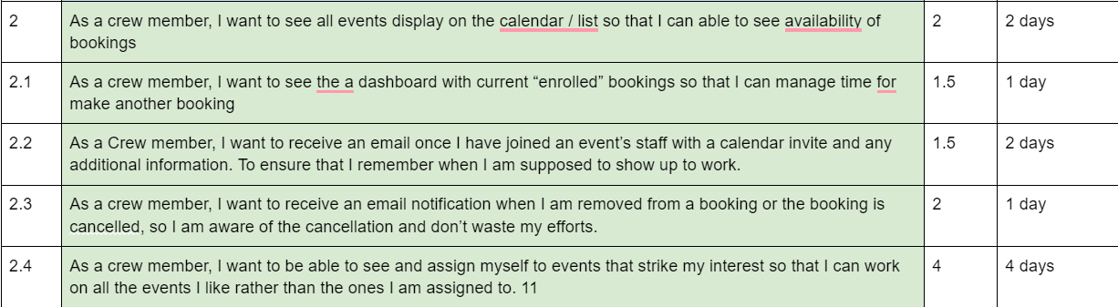
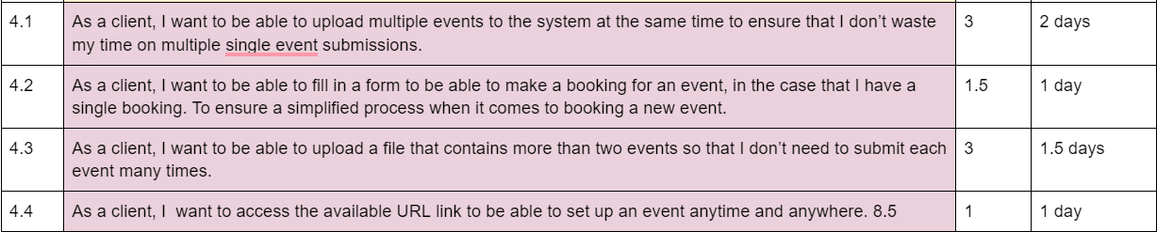
User Stories & Cost Estimation
Client user stories:
12% of all story points
Development for the client is expected to be the least complex.
Crew member user stories:
16% of all story points

Slide 4
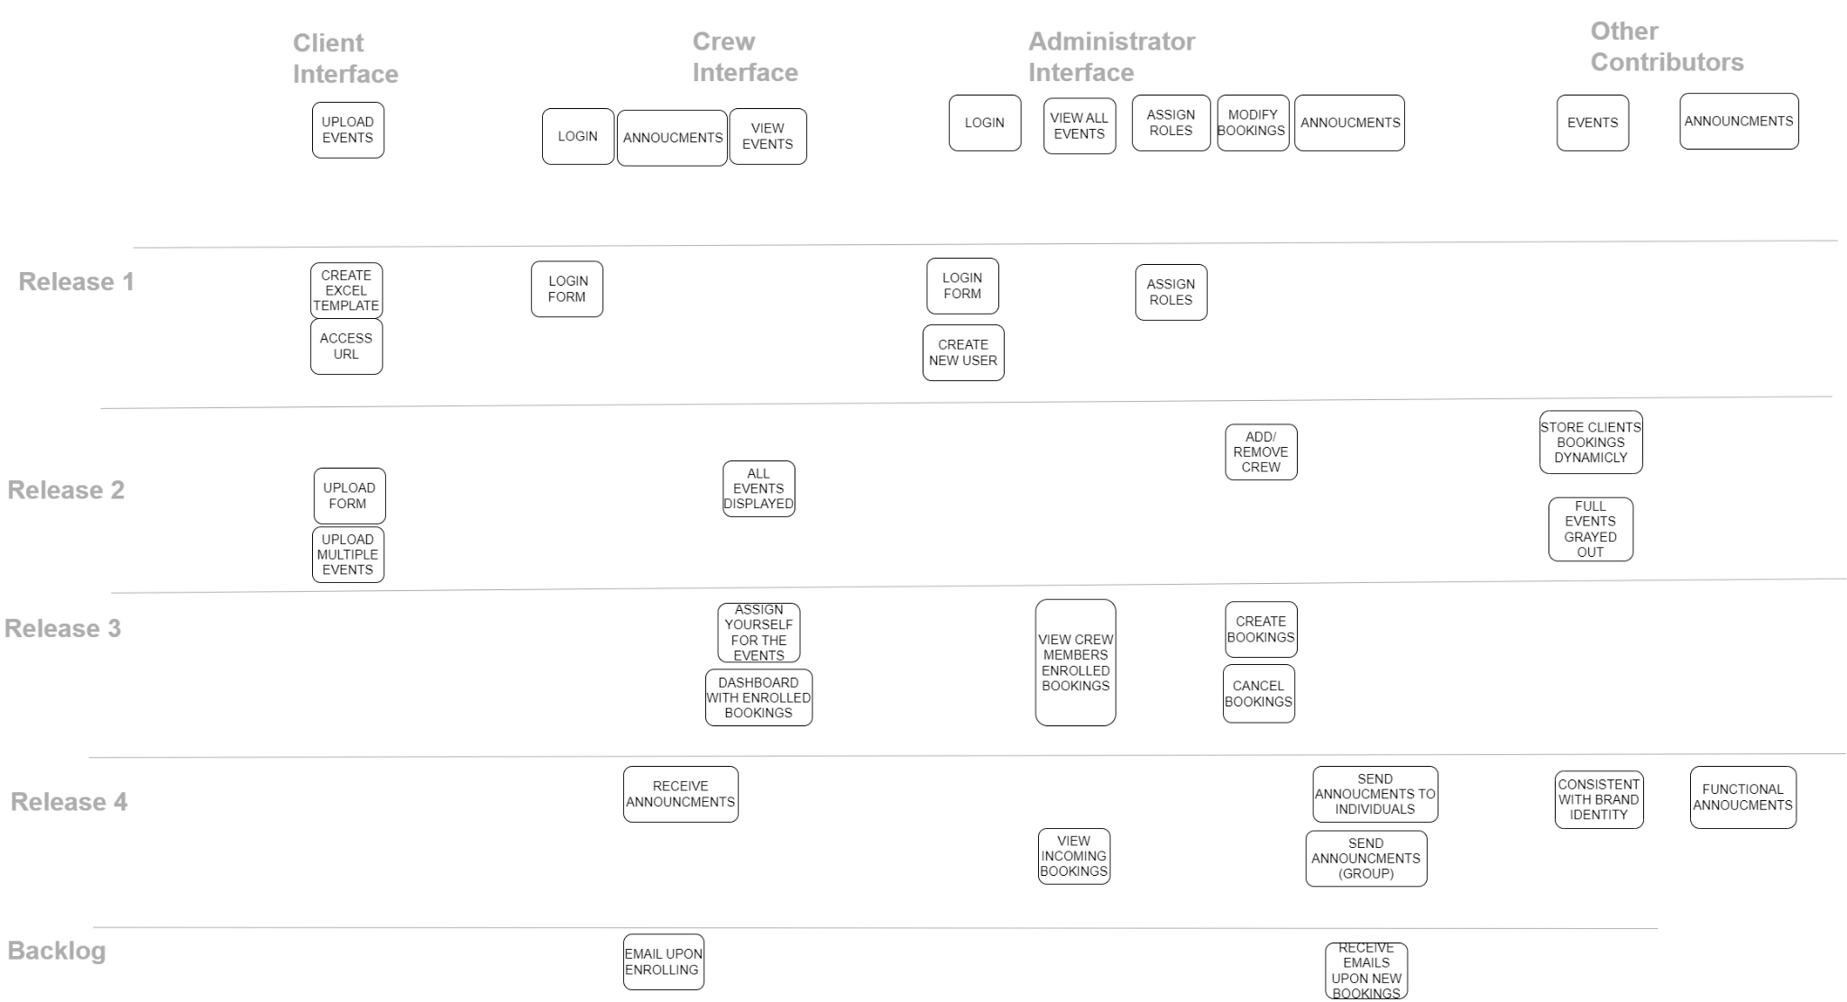
Story Map
Notes:
OS: By use of the Story Map method we wanted to achieve a practical, see-through plan of work. By setting milestones, respectively to the releases, we clear out the steps that need to be taken to develop the product. It clears out what are our main objectives, and what are our tasks within each release. It is set in a chronological order so that it presents what are the essentials- the basic features.

Slide 5
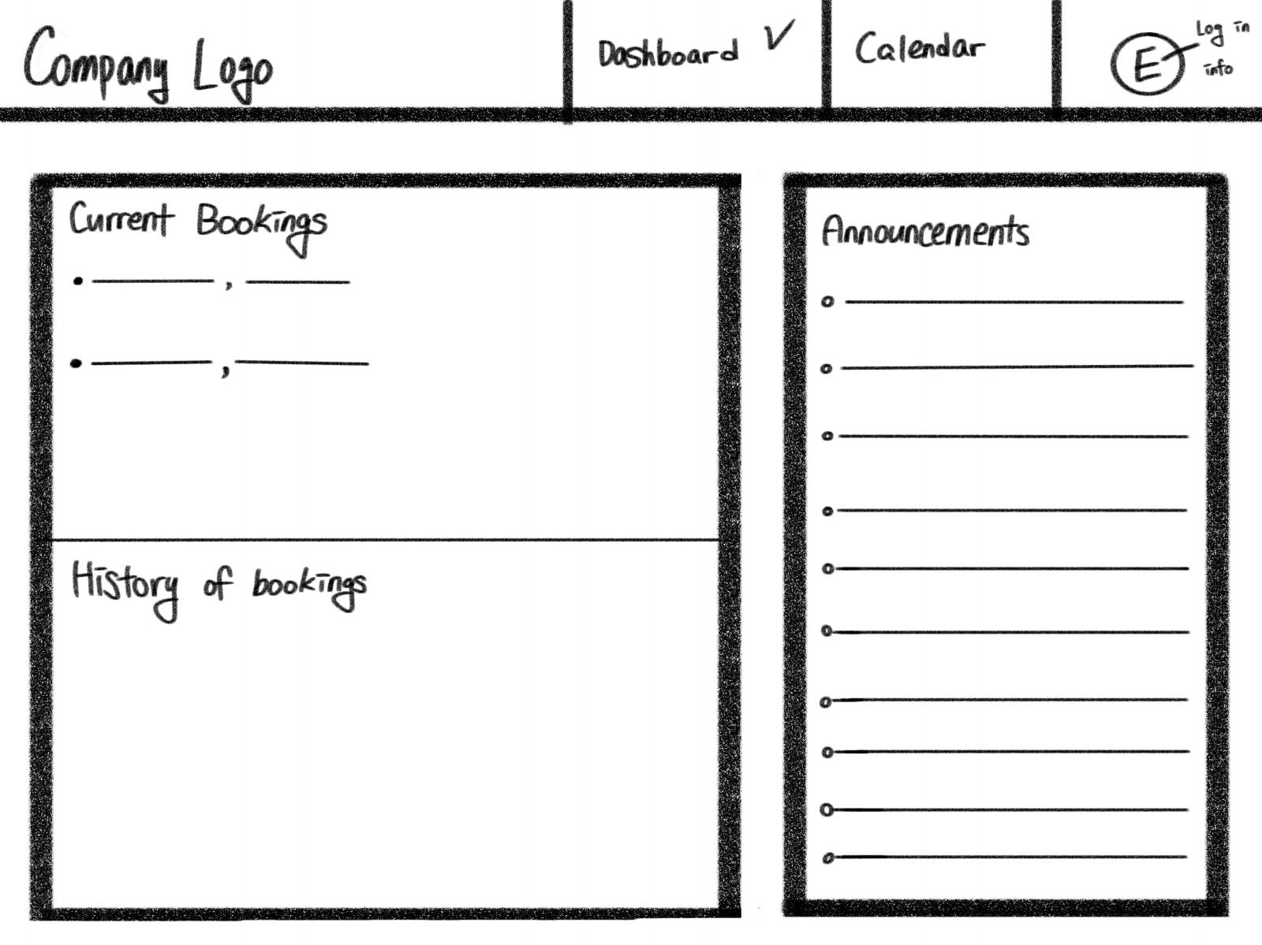
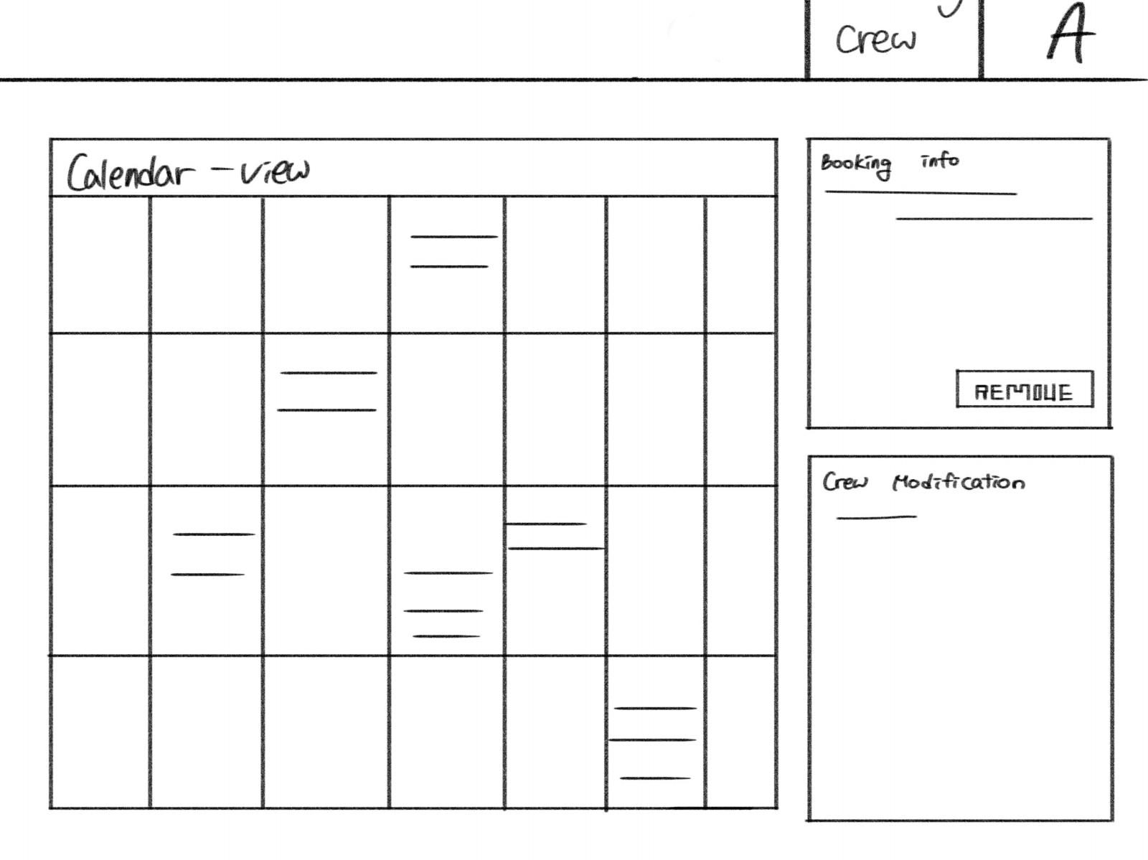
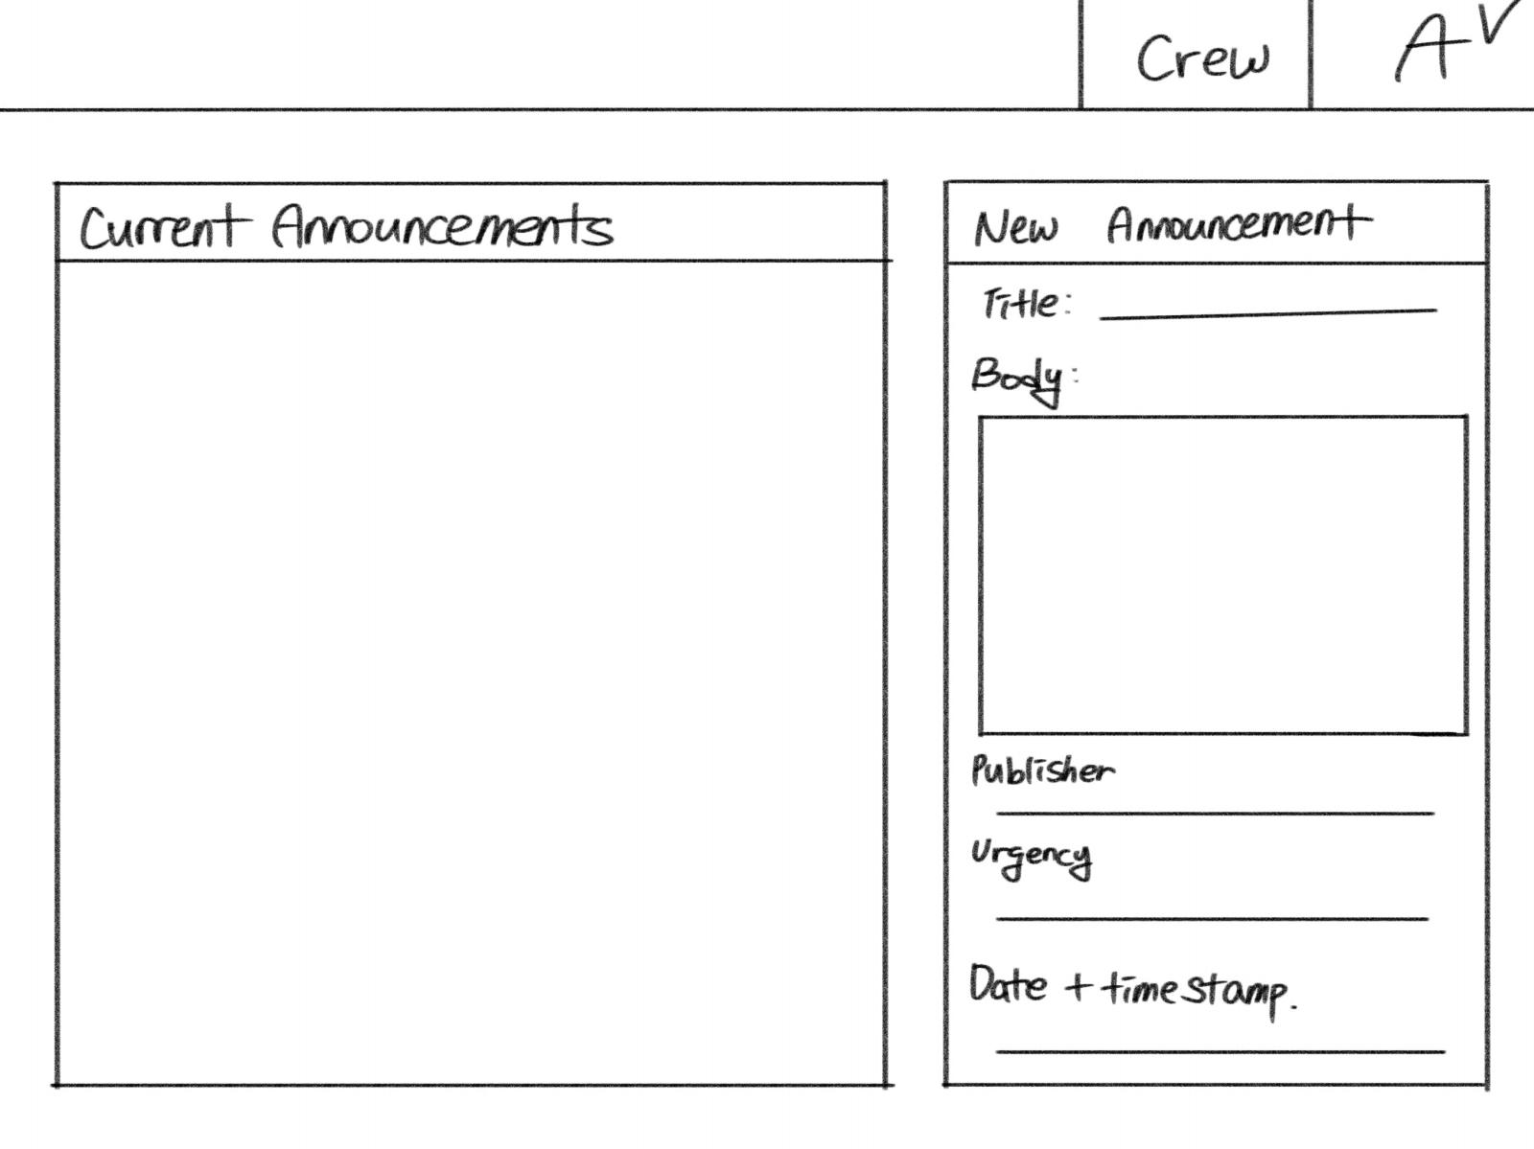
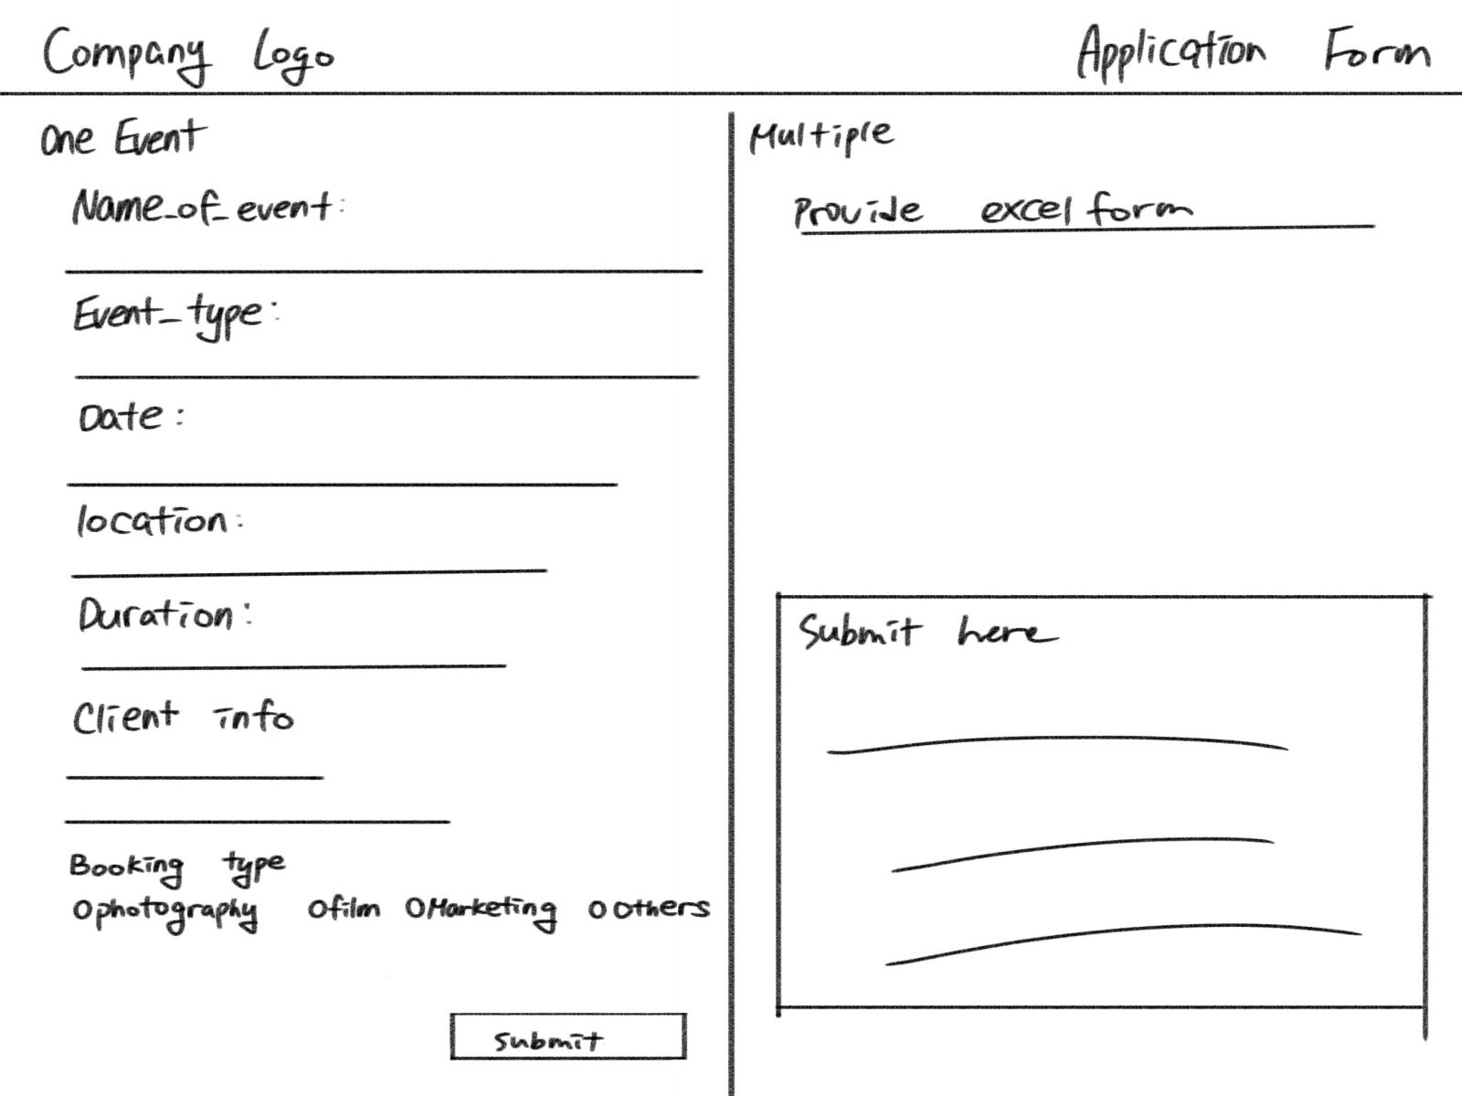
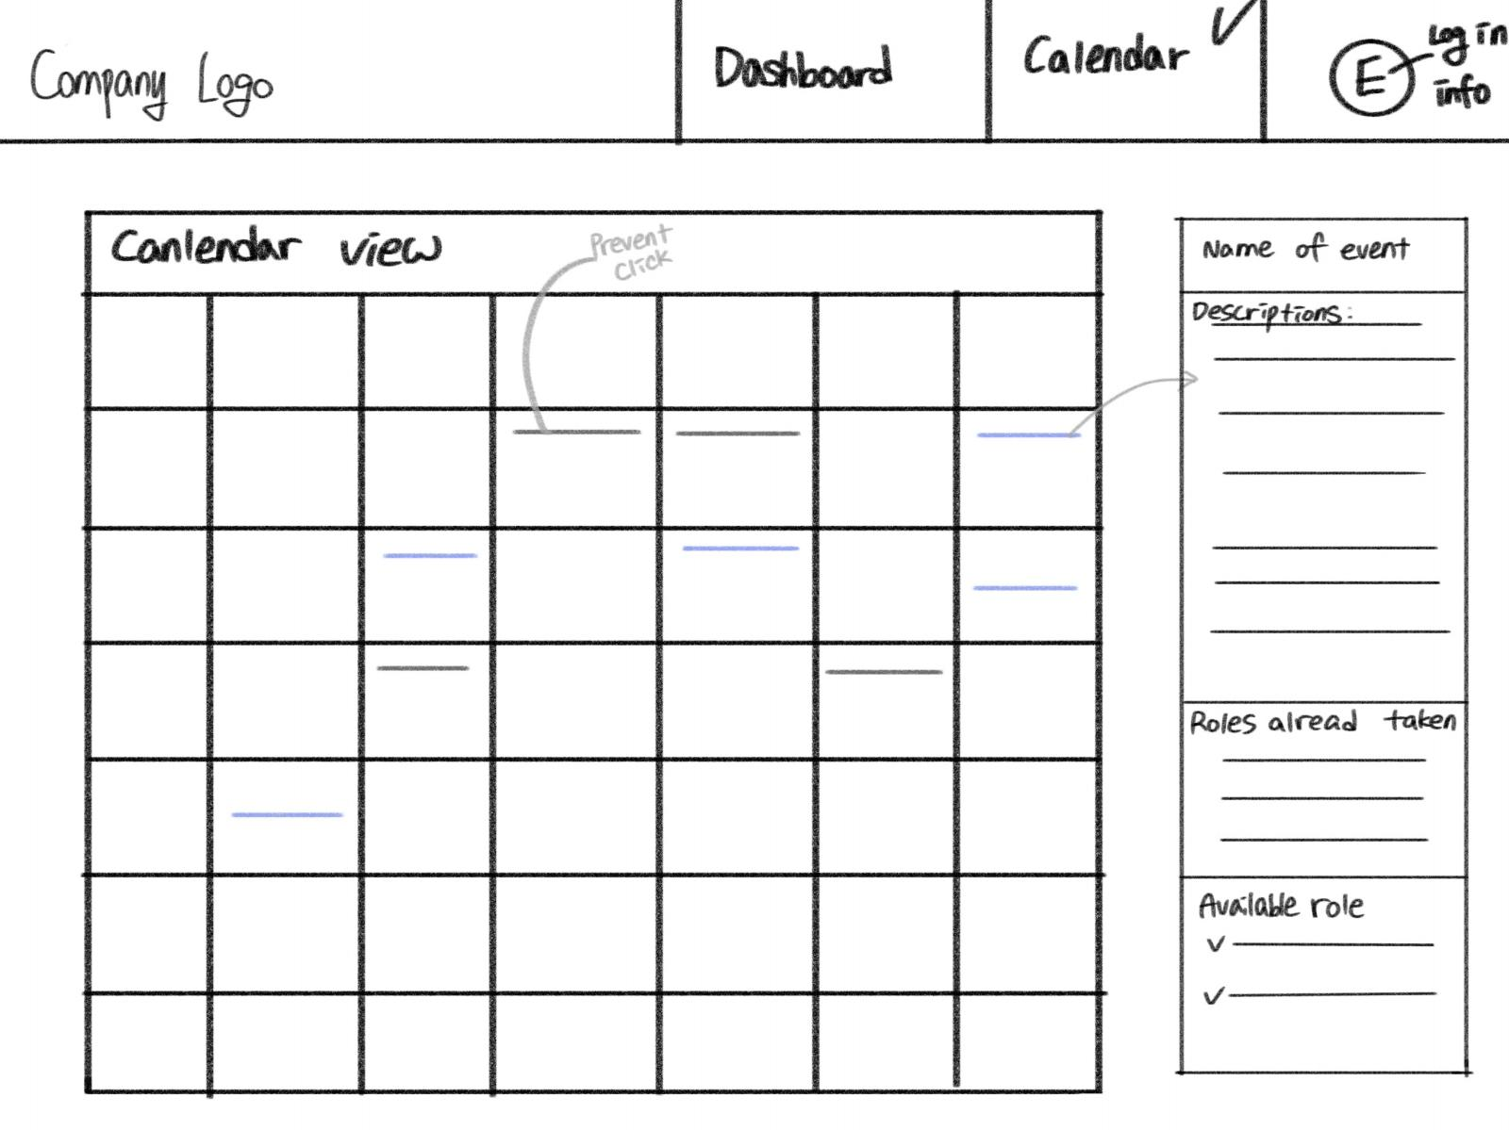
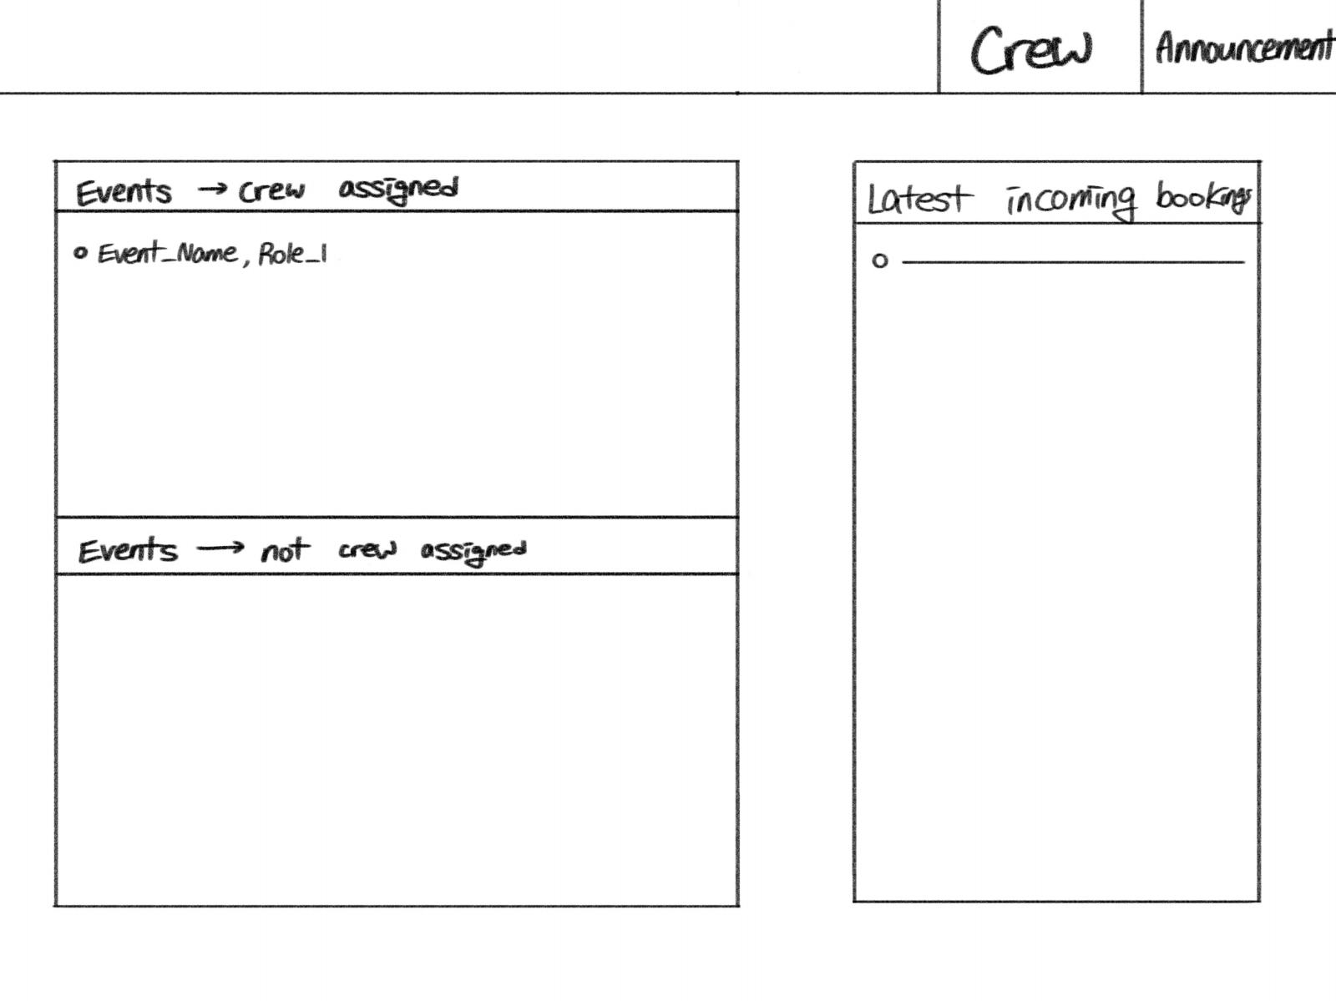
Low fidelity Designs

Slide 6
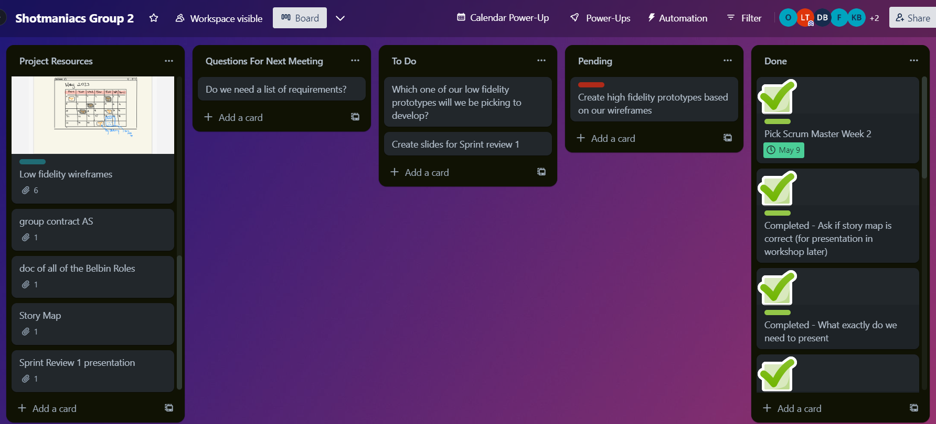
Trello

